Slide 1
CS 1520 COMPUTER ARCHITECTURE
Prof. Peter Edwards
p.edwards@abdn.ac.uk
Notes:
Some slides in this set adapted from:
Digital Design and Computer Architecture, 2nd Edition
David Money Harris and Sarah L. Harris

Slide 2
Logic Circuits

Slide 3
From Logic to Gates
A schematic is a diagram of a digital circuit showing the elements and the wires that connect them together.
Example: Y = ABC + ABC + ABC

Slide 4
Circuit Schematic Rules
Inputs on the left (or top) of a schematic.
Outputs on right (or bottom) of a schematic.
Whenever possible, gates flow from left to right.
Straight wires are best!
Wires always connect at a T junction
A dot where wires cross indicates a connection between the wires
Wires crossing without a dot make no connection

Slide 5
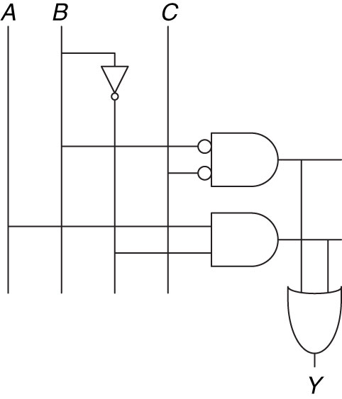
Example
simplification
Y = ABC + ABC + ABC
Y = BC + AB
Notes:
The simplified circuit has significantly less hardware than the original one.
It may also be faster because of gates with fewer inputs

Slide 6
Don’t Cares & Karnaugh Maps

Slide 7
Multiple Output Circuits
Example: Priority Circuit Output asserted corresponding to
most significant TRUE input
A₃
A₂
A₁
A₀
Y₃
Y₂
Y₁
Y₀
PRIORITY CIRCUIT

Slide 8
Priority Circuit

Slide 9
Don’t Cares !
Here, symbol ‘X’ is used to indicate that we don’t care about the value of that variable.

Slide 10
X’s & Z’s
Boolean algebra is limited to 0s and 1s.
However, real circuits can also have illegal and floating values, represented symbolically by X and Z.
Illegal Value: X
The symbol X indicates that the circuit node has an unknown or illegal value.
Floating Value: Z
The symbol Z indicates a node is being driven neither HIGH nor LOW.

Slide 11
Contention (X)
Contention: Circuit tries to drive output to 1 and 0
Actual value somewhere in between
Could be 0, 1, or in forbidden zone
Might change with voltage, temperature, time, noise
Warning!
Contention usually indicates a bug.
X is used for “don’t care” and contention - look at the context to tell them apart

Slide 12
Karnaugh Maps (K-Maps)
Simplifying Boolean expressions via algebraic manipulation is hard since there is no uniform way of doing it …
Karnaugh map (or K-Map) technique is a commonly used graphical method.
Another way to present truth table.
Can represent Boolean functions of up to six variables.
K-Maps are tables of rows and columns with entries representing 1s or 0s of SOP and POS representations (minterms or maxterms).
Notes:
From here onwards we will use minterms in our examples.

Slide 13
K-Map Example
Y
A B C Y
0 0 0 1
0 0 1 1
0 1 0 0
0 1 1 0
1 0 0 0
1 0 1 0
1 1 0 0
1 1 1 0
AB
C
00
01
11
10
0
ABC
ABC
ABC
ABC
ABC
ABC
ABC
ABC
1
Y
AB
C
00
01
11
10
0
0
Y = AB
1
0
0
1
0
0
0
1

Slide 14
K-Map
An n-variable K-Map has 2^{n} cells with each cell corresponding to an n-variable truth table value.
K-Map cells are labeled with the corresponding truth-table row.
K-Map cells are arranged such that adjacent cells correspond to truth rows that differ in only one bit position (logical adjacency).
3 variables (A, B, C) – 2³ (8) K-Map cells.
Y
AB
C
00
01
11
10
0
ABC
ABC
ABC
ABC
ABC
ABC
ABC
ABC
1
Differ by 1 bit: B vs B
Notes:
Two terms containing an implicant P and the true and complementary forms of some variable A are combined to eliminate A:
PA + P notA = P

Slide 15
K-Map Definitions
Complement: A, B, C
Literal: variable or its complement
A, A, B, B, C, C
Implicant: product of literals
ABC, AC, BC
Prime implicant: implicant corresponding to the largest circle in a K-map

Slide 16
K-Map Rules
Every 1 must be circled at least once
Each circle must span a power of 2 (i.e. 1, 2, 4) adjacent squares in each direction
Each circle must be as large as possible
A circle may wrap around the edges
A “don't care” (X) is circled only if it helps minimize the equation.

Slide 17
4-Input K-Map Example
Start, by drawing out the grid …
Y
AB
CD
00
01
11
10
00
01
11
10

Slide 18
4-Input K-Map Example
Write the values of Y into the grid.
Y
AB
CD
00
01
11
10
0
0
00
1
1
1
0
01
0
1
1
0
11
1
0
10
0
1
1
1

Slide 19
4-Input K-Map Example
Circle groups of 2, 4 or 8 adjacent squares.
Y
AB
CD
00
01
11
10
0
0
00
1
1
1
0
01
0
1
1
0
11
1
0
10
Don’t forget wrap-around!
0
1
1
1

Slide 20
4-Input K-Map Example
Y
Y
AB
AB
CD
00
01
11
10
CD
00
01
11
10
0
0
0
0
00
1
1
ABCD
ABCD
00
1
0
ABCD
0
1
0
0
01
01
ABCD
1
0
0
11
1
0
11
0
ABCD
ABCD
10
0
10
0
1
ABCD
ABCD
1
ABCD
1
Y = AC + ABD + ABC + BD

Slide 21
K-Maps with Don’t Cares

Slide 22
K-Maps with Don’t Cares
Write in the values of the the function (Y) from the truth table.

Slide 23
K-Maps with Don’t Cares
Circle groups of 2, 4 or 8 adjacent squares.
Notes:
How do we arrive at solution?
Consider largest group of 8 squares (bottom 2 rows of grid):
not(A)not(B)CD not(A)BCD ABCD Anot(B)CD
not(A)not(B)Cnot(D) not(A)BCnot(D) ABCnot(D) Anot(B)Cnot(D)
This resolves into: C
Other largest group of 8 squares (3rd and 4th columns of grid):
ABnot(C)not(D) Anot(B)not(C)not(D)
ABnot(C)D Anot(B)not(C)D
ABCD Anot(B)CD
ABCnot(D) Anot(B)Cnot(D)
This resolves into: A
Last remaining circle includes the top-left square (not yet included) and also includes the other corner squares:
not(A)not(B)not(C)not(D)
Anot(B)Cnot(D)
Anot(B)not(C)not(D)
not(A)not(B)Cnot(D)
This resolves into: not(B)not(D)
GIVING FINAL RESULT:
A + not(B)not(D) + C

